Slide 1
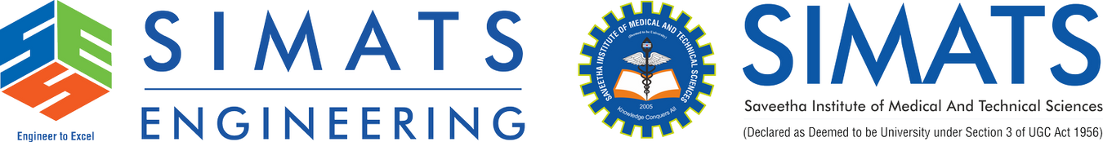
CLOUD SECURITY FUNDAMENTALS: PROTECTING DATA AND APPLICATIONS
CLOUD COMPUTING AND BIT DATA ANALYSIS CSA1507
GUIDED BY :
Dr ANURADHA C
PRESENTED BY :
ARUNPANDIAN K(192511086)
MANU NEETHI S(192521063)

Slide 2


INTRODUCTION
Cloud Computing Provides Scalable And Cost-Effective Digital Infrastructure Services.
Cloud Security Protects Data, Applications, And Network Resources Effectively.
Security Ensures Confidentiality, Integrity, And Availability Of Cloud Environments.
Strong Security Minimizes Cyberattacks And Unauthorized Data Access.

Slide 3
LITERATURE SURVEY
YEAR | AUTHOR | CONTRIBUTION | LIMITATION
2022 | Smith Et Al. | Advanced Encryption Improved Secure Cloud Data Protection Significantly. | Complex Key Management Increased Implementation Difficulty.
2023 | Johnson Et Al. | Multi-Factor Authentication Reduced Unauthorized Cloud Access Attempts. | Increased Authentication Time For End Users.
2024 | Lee Et Al. | AI-Based Monitoring Enhanced Real-Time Cloud Threat Detection Accuracy. | Required High Computational Resources And Continuous Training.
2025 | Kumar Et Al. | Zero Trust Architecture Strengthened Cloud Security Against Modern Attacks. | Deployment Complexity Increased Organizational Implementation Costs.

Slide 4
PROBLEM STATEMENT
Sensitive Cloud Data Faces Increasing Cyber Threats And Attacks.
Weak Authentication Exposes Systems To Unauthorized User Access.
Data Breaches Cause Financial Losses And Privacy Violations.
Organizations Require Stronger Cloud Security Protection Mechanisms.

Slide 5
.
OBJECTIVES
To Protect Cloud Data From Cyber Threats And Unauthorized Access.
To Implement Encryption And Multi-Factor Authentication For Enhanced Security.
To Monitor Cloud Activities To Detect Suspicious Behavior Continuously.
To Improve Availability, Integrity, And Confidentiality Of Cloud Resources

Slide 6
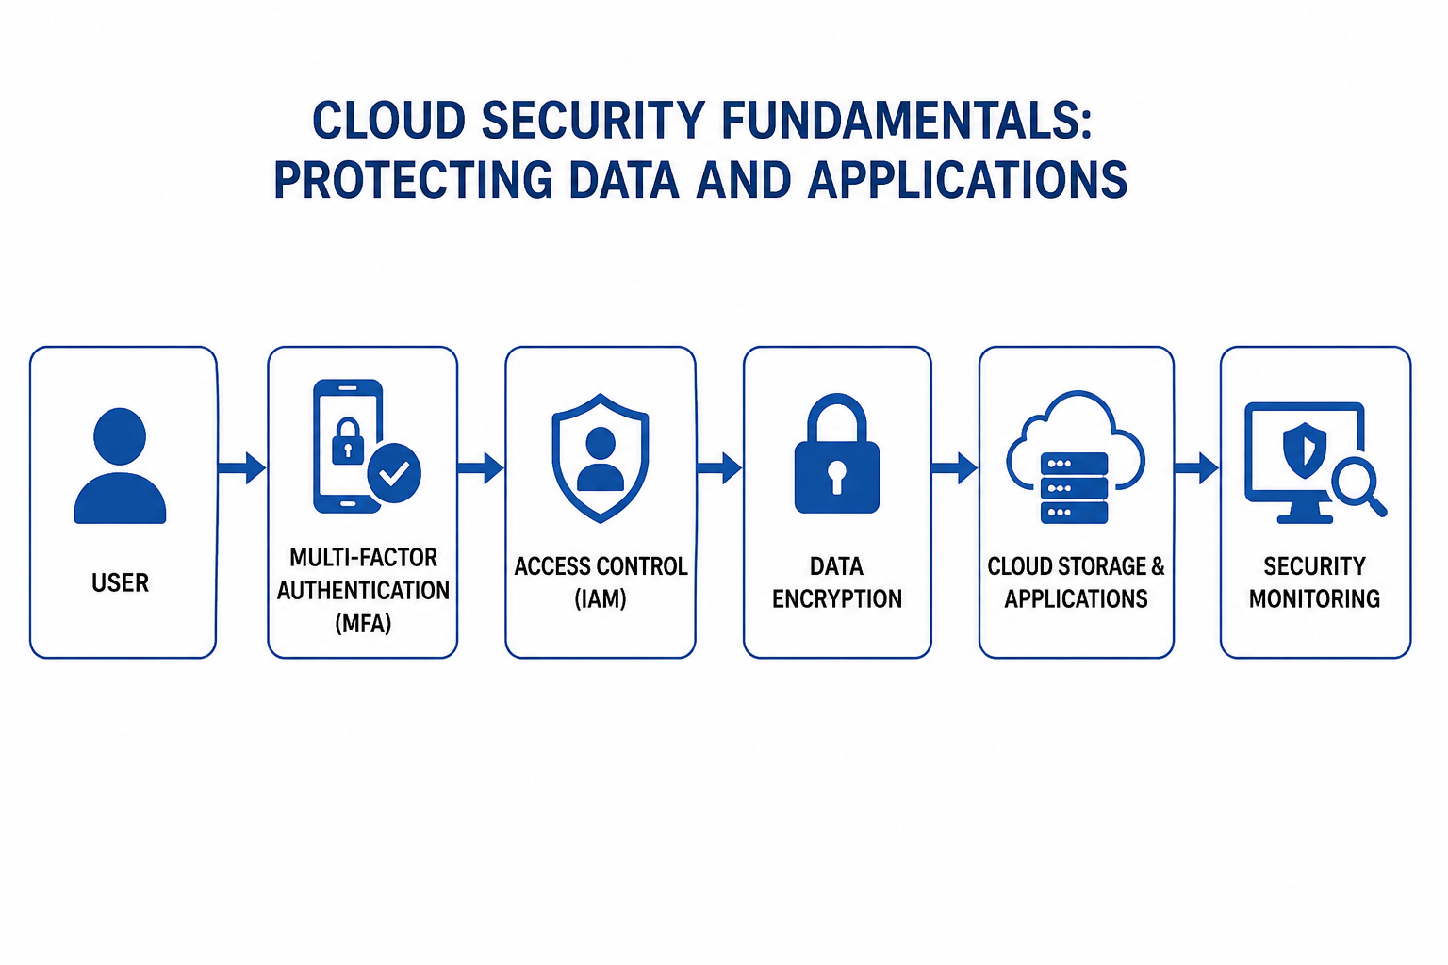
SYSTEM ARCHITECTURE

Slide 7
PROPOSED SYSTEM
Encrypt Cloud Data Using Advanced Cryptographic Security Techniques.
Authenticate Users Through Multi-Factor Authentication Mechanisms.
Monitor Cloud Infrastructure With Real-Time Threat Detection Systems.
Apply Role-Based Access Control For Secure Resource Management.

Slide 8
ADVANTAGES
Protects Confidential Cloud Data From Cyber Attacks.
Prevents Unauthorized Access Using Advanced Authentication Methods.
Enhances Regulatory Compliance And Organizational Security.
Improves Business Continuity With Reliable Cloud Protection

Slide 9
CONCLUSION
Cloud Security Safeguards Sensitive Organizational Data And Applications.
Encryption And Authentication Strengthen Overall Cloud Protection.
Continuous Monitoring Improves Threat Detection And Response Capabilities.
Secure Cloud Environments Enable Reliable Digital Transformation.

Slide 10
REFERENCE
NIST. Security And Privacy Controls For Information Systems And Organizations.National Institute Of Standards And Technology, 2020.
Amazon Web Services (AWS). AWS Security Best Practices. AWS Documentation, 2024.
Microsoft. Azure Security Documentation. Microsoft Learn, 2024. Google Cloud.
Google Cloud Security Overview. Google Cloud Documentation, 2024.
CSA (Cloud Security Alliance). Security Guidance For Critical Areas Of Focus In Cloud Computing V5.0. Cloud Security Alliance, 2024.

Slide 11


Slide 12
